Slide 1
Symphony of the Scriptures
Numbers

Slide 2
Numbers
The book covers a span of nearly 40 years (circa 1445-1406 B.C.).
“…behold, you have sinned against the Lord, and be sure your sin will find you out” (32:23)
Preparation
Census
Organization
Sanctification
Pessimism
Complaining
Doubting
Promised Land Rejected
Punishment
Wandering
Old Generation Dies
New Census
Chapters 1-9
Chapters 10-14
Chapters 15-16
Place
20 Days
Several Months
40 years approx.
Time
Mount Sinai
Route to Kadesh Barnea
Wilderness Wanderings
Theme
The price of disbelief and disobedience
Key Verses
14:22-23
Christ in
Numbers
Pictured in manna (compare Jhn. 6:31-33); water from rock (compare 1 Cor. 10:4); bronze serpent (compare Jhn. 3:14), etc.
Notes:
Genesis ends with Jacob’s (Israel) descendants in Egypt. As you recall the Israelites prosperity had worried Pharaoh until he forces the Israelites into slavery. We have learned that God has told His people whom to worship, when to worship, where to worship, and how to worship. God provides for the exodus of His people and gives them law to protect and keep them, and the Book of Numbers picks up with the people of God being organized or numbered. Accordingly, every man over 20 is accounted for with 603,550 the sum, excluding the Levites. I could not help but observe that when a census is taken about thirty-eight years later - a loss of 1820. We learn that the people leave Mt. Sinai (Horeb) and are eleven days from the southern-most part of Canaan, Kadesh-Barnea (see Deut. 1:2). We know that 40 years were spent wandering around the wilderness of Paran because of the grumbling nature of the Israelites (32:13). The middle part of the Book explains why the population decreased as as the complaining increased. In spite of God’s continual guidance and protection the people were unhappy. He provides manna from above, clothes that never ware out, water from a rock, and a cloud over the tabernacle that became a fire at night. When the cloud lifted the people would continue their pilgrimage until it stopped; there they would settle until it moved again. Because of their complaining a plague is placed upon them and many die as a result of their murmuring (11:31-34). They continue with their complaining and they refuse to take the land that “God had given them” (Nu. 13:2) preferring to believe the negative report of the ten spies over the advice of Joshua and Caleb. That said, God again thins out the crowd when He instructs them to look upon a “serpent of brass” t (“Nehustan”) to avoid death from the deadly bite of a serpent (21:7). Obeying God demands total acceptance of His word and the discipline to obey, even when our logic dictates otherwise. Numbers shows the failures of the Israelites to obey; consequently, only Joshua and Caleb of their generation were allowed to cross over into Canaan because “they have wholly followed the Lord” (32:12; 26:65).
Application:
Complaining is usually contagious. Ingratitude and grumbling will poison a congregation.
Doubting is often disastrous - it shows itself as unbelief or a fickled faith. We would do well to remember that it was this doubt that prohibited the Israelites from enteriing into the promise land.
Wandering is humbling - Eleven days or 40 years? How’s our journey going? (Deut. 1:2).
Key thought: We are all pilgrims - just passing through thus life - each of us on our spiritual journey. Are we in a wilderness aimlessly wandering? Are we lost and confused? Will we be like Joshua and Caleb or like the majority who feared the wrong thing?

Slide 3
Period | History Covered | Scriptures | Years | Principal
Antediluvian | Creation to the Flood | Gen. 1-7 | 1656 | Adam
Postdiluvian | From the flood to call of Abraham | Gen. 8-!1 | 427 | Noah
Patriarchal | From the call of Abraham to Egyptian Bondage | Gen. 12-45 | 215 | Abraham
Egyptian Bondage | From Egyptian Bondage to the Exodus | Gen. 46-Ex. 11 | 215 | Joseph
Wilderness Wanderings | From Exodus to crossing of the Jordan | Ex. 12-Deut. 34 | 40 | Moses
Conquest of Canaan | From crossing of Jordan to Joshua’s death | Josh. 1-24 | 51 | Joshua
Judges | From Joshua to King Saul | Ju, Ruth, 1 Sa. 1-9 | 305 | Samuel
The United Kingdom | From origin of kingdom to its division | 1 Sa. 9-1 Ki. 11; 1 Chr. 10, 2 Chr. 9 | 120 | David
The Divided Kingdom | From the division to the fall of Israel | 1 Ki. 12-2 Ki. 20; 2 Chr. 10-32 | 253 | Elijah
Judah Alone | From fall of Israel to the fall of Judah | 2 Ki. 21-25; 2 Chr. 10-32 | 125 | Josiah
Babylonian Captivity | From the fall of Judah to the return | 2 Ki. 25-8- 21; Dan. 1-6 | 70 | Daniel
Restoration of the Jews | From the return to end of OT history | Ezra, Nehemiah | 92 | Ezra
Between the Testaments | From end of OT to the beginning of the NT | None | 400 | Judas Maccabe
Life of Christ | From birth of Jesus to ascension | Mt-Jhn 21; Acts1 | 34 | Jesus
The Church | From ascension to death of Paul (96 AD approx.) | Acts 2-Revelation | 70 | Paul

Slide 4
The Pentateuch
Book of the Pentateuch | What it tells us about humanity | What it tells us about God
Genesis | Ruin and rebellion through sin | Sovereignty
Exodus | Redemption from bondage | Omnipotence
Leviticus | Communion and fellowship | Holiness
Numbers | Redirection | Justice
Deuteronomy | Instruction | Faithfulness
Notes:
The first five books of the Bible make up the Pentateuch (from penta, the Greek word for five, and teuchos, which means tool). Otherwise known as the Torah - Each the five books written by Moses.

Slide 5
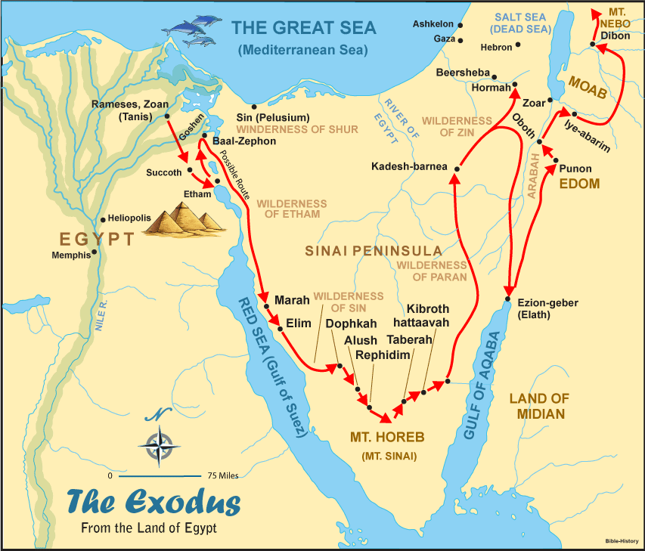

Slide 6
Who wrote the book?
As it does for the rest of the Pentateuch, universal Jewish and Christian tradition attributes the authorship of the book of Numbers to Moses. Moses is the central figure within the book, and in at least two instances Numbers mentions him recording events by the Lord’s commands (Nu. 33:2; 36:13).
The name “Numbers” is a translation of Arithmoi, from the Septuagint, titled thus because the book contains many statistics, population counts, tribal and priestly figures, and other numerical data. The Hebrew name comes from the first sentence of the book and means “in the desert of ”; it is perhaps an even more accurate description of the book’s content, which follows the Israelites through almost forty years of wandering in the desert.

Slide 7
Where are we?
The events of the book began in the second year after the Israelites departed Egypt, as they camped at Mount Sinai around 1444 BC (1:1). The narrative ends thirty-eight years later “in the plains of Moab by the Jordan opposite Jericho” (36:13) in 1406 BC. Numbers records the people’s long wandering in the desert of Sinai, their time at the oasis of Kadesh-barnea, and their eventual arrival at the banks of the Jordan River across from the Promised Land.
The Lord directed the message of Numbers toward the younger generation, children of the former slaves who escaped through the Red Sea. Except for Joshua, Caleb, and Moses, the older generation—everyone twenty years old or older at the time of the first census—died before the completion of Numbers, due to their disobedience and disbelief (14:22–30). Moses completed the book before his death (Deut. 31:24).

Slide 8
Why is Numbers so important?
Numbers takes the reader on a long and winding path through a desert of excruciating detail. The book records census results for all twelve tribes not once, but twice; it documents priestly instructions for handling the Ark of the Covenant and the tabernacle; and it even spells out the placement of the tribes when they camped. But through it all, we cannot doubt God’s unfailing direction over the nation. As a history of the nation not yet established in the land promised them long ago, this book unveils significant events sometimes referenced later in Scripture. Joshua and Caleb alone among the twelve spies encouraged Israel to take possession of the land (13–14; Josh. 14:7); Moses struck a rock and water spouted forth (20:11; Psa. 106:32); Moses lifted up a bronze serpent on a pole so that believing Israelites might be healed of their snake bites (21:6–9; John 3:14); and Balaam was rebuked by his donkey (22:21–34; Rev. 2:14).

Slide 9
What's the point?
In this book, the people of Israel tested God’s patience, and He in turn tested their endurance and faithfulness. Though the people failed many times, God showed His own faithfulness by His constant presence leading the way: through a cloud by day and a pillar of fire by night.
More than just a history lesson, the book of Numbers reveals how God reminded Israel that He does not tolerate rebellion, complaining, and disbelief without invoking consequences. He taught His people how to walk with Him—not just with their feet through the wilderness but with their mouths in worship, hands in service, and lives as witnesses to the surrounding nations. He was their God, they were His people, and He expected them to act like it.

Slide 10
How do I apply this?
Modern readers can take away from Numbers not only a thorough history of Israel’s early days but also a renewed sense of God’s delight in obedience. He is our God, too, and He wants us to live righteously, worshipping Him through our words and works. The journey of the Israelites through the wilderness earned the apostle Paul’s notice when he penned his first letter to the Corinthian church. “These things happened,” he wrote in 1 Corinthians 10:6, “as examples for us, so that we would not crave evil things as they also craved.” Do you see any resemblance between the grumbling, rebellious Israelites and yourself? How can you avoid following their example? With humility and sincerity, pray for a soft heart, open to God’s guiding hand.

Slide 11
Brief Outline
Chapter 1 Men of war numbered.
Chapter 2 Order of March and encampment.
Chapter 3 Selection and numbering of the Levites as God’s priests.
Chapter 4 Duties of the Sons of Levi.
Chapter 5 The Law of Jealousy
Chapter 6 The Law of the Nazirite Vow.
Chapter 7 The Princes of Israel offer Dedication Sacrifices for the Altar of Burnt Offering.
Chapter 8 Levites are separated and cleansed for the work God ordained for them.
Chapter 9 Israel charged to keep the Passover Feast / instructions given to follow God through the wilderness by a cloud in the day time and a pillar of fire at night.
Chapter 10 Israel commanded to leave Sinai on the 20th day of the 2nd month of the 2nd year. According to Exodus 19:1 it is apparent that Israel remained at Sinai receiving instructions for one year (twelve months). Chapter 11 God’s anger is kindled against Israel because they begin to complain about the journey and manna. Chapter 12 Miriam and Aaron question Moses’ authority and thereby sin against Jehovah.

Slide 12
Chapter 13 12 spies sent into Canaan. Joshua and Caleb display a spirit of faith whereas the other ten spies display an unfaithful spirit of defeatism.
Chapter 14 The spirit of unfaithfulness spreads to the whole congregation of God’s people and they begin to murmur against God. The Lord’s anger is kindled again and he pronounces a forty-year period of wandering that all the complainers may die in the wilderness.
Chapter 15 God reveals the two-sided nature of mankind. First, there is the man who sins with an unwitting pirit and secondly there is the one who sins with a high-handed spirit. All sin yet God desires man to take advantage of His gracious offer to forgive through one’s obedience.
Chapter 16 Korah’s rebellion against God’s sovereign choice of Aaron and Moses.
Chapter 17 God makes it known to all Israel that His sovereign choice for the priesthood was the sons of Aaron. The Lord request that the 12 tribes bring a staff before the Lord and the one that buds would be God’s choice for the priesthood. The Lord caused Aaron’s rod to bud.
Chapter 18 The Levites were to receive a tithe through the heave offerings to be their physical portion. The Levites would not participate in work like the rest of the tribes and were to thereby be supported by the others to do the work of the tabernacle. God would be their portion and inheritance much like He is to all Christians today.
Chapter 19 As Israel wandered in the wilderness for forty years they often came in contact with the dead. Said contact defiled them and they were commanded to go through a procedure to be clean. Those unwilling, through a spirit of rebellion, to go through the cleansing process were to be separated from the congregation.
Chapter 20 After the years of wandering in the wilderness the people return to Kadesh-Barnea and there is no water to drink. The congregation complains to Moses and Aaron yet on this occasion God tests the spirit of Moses and Aaron. The two leaders fail and God determines to lead the Israelites into Canaan by the leadership of another.

Slide 13
Chapter 21 People complain against Moses and God due to the journey and manna. God causes snakes to bite the people and many die. They repent and re-gain God’s favor. Israel then defeats Ammon.
Chapter 22 The King of Moab fears Israel and thereby sends for Balaam that he may curse Israel. Balaam is rebuked by his own donkey.
Chapter 23 Balaam blesses Israel.
Chapter 24 Balaam blesses Israel a third time and Balak is angered.
Chapter 25 Bothered by not receiving the rewards and honor offered by Balak, Balaam causes Israel to be cursed. Twenty four thousand Israelites die due to their being joined to Baal-peor. Phinehas displays a spirit of conviction.
Chapter 26 God commands Moses to number the people again for the purpose of dividing Canaan.
Chapter 27 Laws concerning inheritance of land and the choosing of Joshua to replace Moses as leader or shepherd over God’s people.
Chapter 28 Laws regarding sacrifices and set feasts days.
Chapter 29 Laws regarding sacrifices and set feasts days.
Chapter 30 Laws regarding vows or oaths.
Chapter 31 Israel wars with the Midianites at the request of Jehovah.
Chapter 32 Gad, Reuben, and half the tribe of Manasseh request the land east of the Jordan due to it being good for livestock.
Chapter 33 The Lord commands Moses to write down all the travels of Israel from Egypt to Moab.
Chapter 34 The Lord reveals to Moses the boundaries of the land of Canaan.
Chapter 35 Laws regarding Levitical cities and murder.
Chapter 36 Addendum law on inheritance of land.

